Slide 1

Coursera Capstone Project-The battle for neighborhoods
Baichuan Chu

Slide 2
Introduction and Problems
Today, people are traveling around the world. For example, a lot of students travel to America in order to study here. Meanwhile, there are people who like to have businesses in other counties.
Under the trend, United States and Canada are the popular choices to those people. Among all those popular cities in American and Canada, I will mainly focus on Toronto and New York City
I am trying to solve some of the problems:
Within Toronto and New York City, which boroughs of those two cities contain the most neighborhood?
What are the differences between the two boroughs?(Mainly discuss the differences in their venues.)
Which one of the cities is good for people to travel and study?
Which one of the cities is good for people to open up a Chinese restaurant?

Slide 3
Data
I used several datasets in order to do this project:
Geospace data that allows me to get all coordinates of the boroughs.
The Toronto Neighborhoods data, a Wikipedia data, which allows me to explore all neighborhoods in the Toronto. https://en.wikipedia.org/wiki/List_of_postal_codes_of_Canada:_M
New York data which give me all information about New York City’s boroughs.
FourSqaure is also an important data set to me. It’s a tool, but this tools can let me obtain all the information I need for my analysis. It could tell me the venues around each neighborhoods.

Slide 4
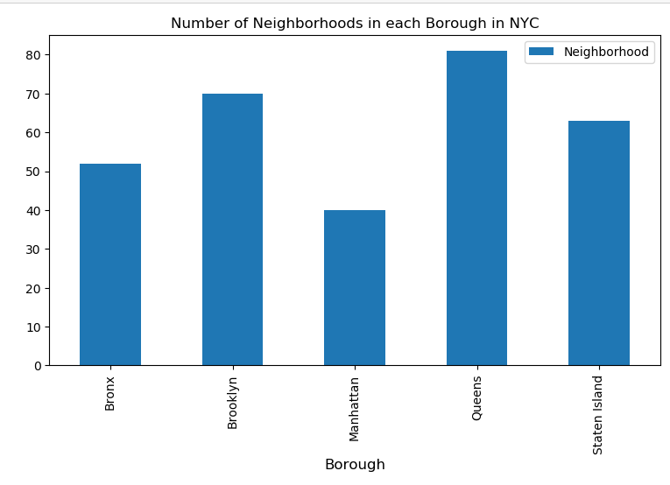
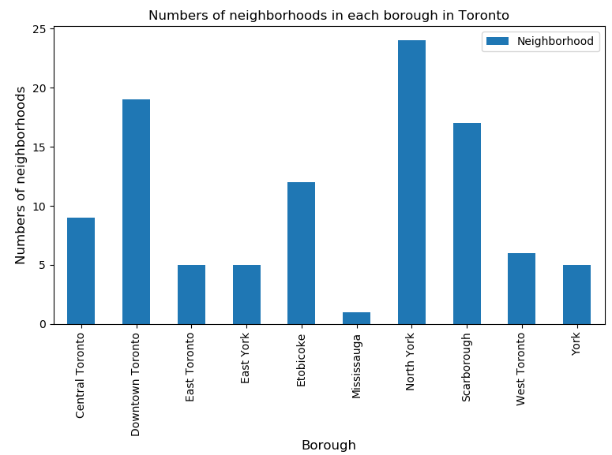
Boroughs: North York, Toronto V.S Queen New York City
Because I mainly focus on Toronto and New York City, I need to pull out the data of neighborhoods in those two cities and create data frames for them.
After having all data in the table, I could use matplotlib function to make bar chart in order to pick the boroughs which have the most neighborhoods.
From the graph I created, we can see that Queen has the most neighborhoods in New York City.
For Toronto, North York is also the most populated one.
Thus, I decide to analyze those two areas.

Slide 5
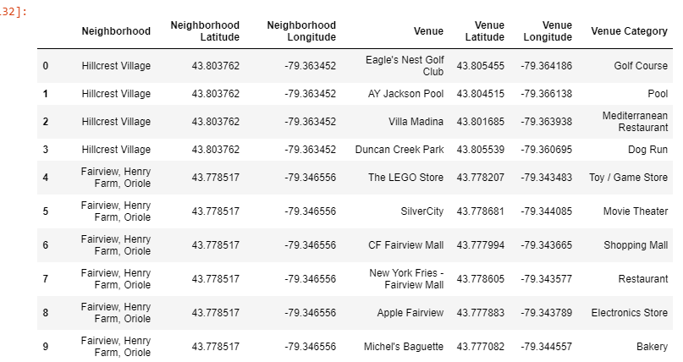
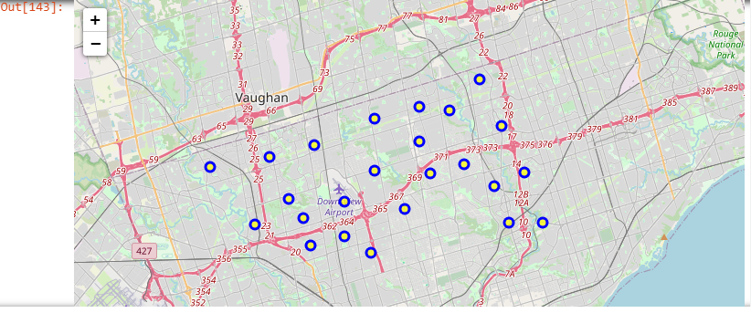
Method Part I:
Toronto:
In previous slides, I choose North York to continue my analysis.
I clean and sort the data from Toronto and pull out all data under neighborhood name “North York”.
After I have the North York data, I use FourSquare to find out the venues around it. Within North York, there are 236 venues in 24 neighborhoods.
Then, I used Kmean to make them into clusters for further analysis.(Cluster picture on the right)

Slide 6
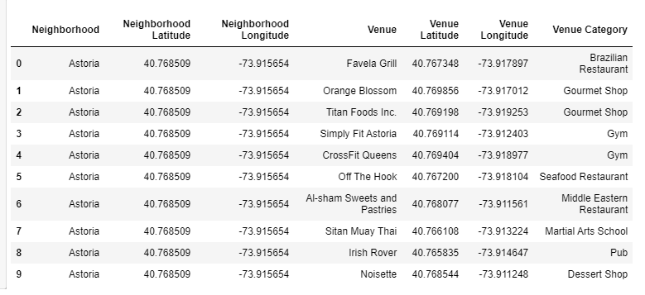
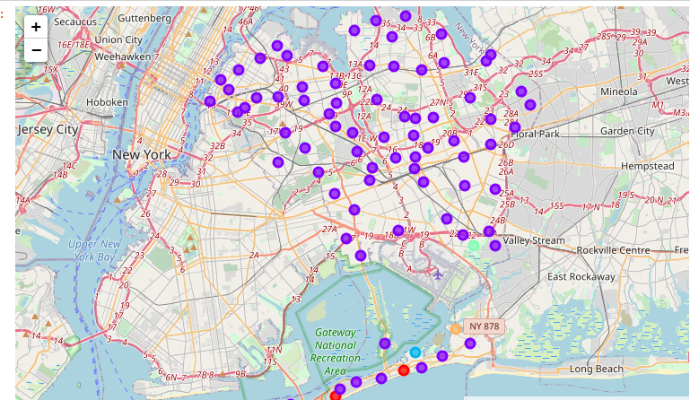
Method Part II:
New York:
For New York, I choose Queen.
Almost did the same thing in Toronto.
Pull out and sort the Queen data.
Use FourSquare to find the venues around that area.
Use Kmean cluster to make the data into different clusters.

Slide 7
Results: Toronto V.S New York
I made 5 cluster for both Queen and North York.
Let’s compare the clusters from both which contains the most neighborhood.
Comparison:
First of all, Queens has much more venues than North York does.
Queen has 2088 distinct venues. On the other hand, North York has only 236 venues.
In North York, cluster 1 has the most neighborhood. There is only 1 Chinese restaurant appear in the first most common column.
On the other hand, cluster 1 also has the most neighborhood. There are more than 5 Chinese restaurants appear in the first most common column.

Slide 8
Conclusion: Answering the Question
Answer 1: Throughout my project, I found that North York and Queens are the boroughs contains the most neighborhoods in Toronto and New York City.
Answer 2: There are many differences between each neighborhoods:
Queen is way bigger than North York in terms of neighborhoods.
Queen contains way more venue categories than North York, especially Chinese restaurants.
Compare to Queen, North York could be a place for people to open up more business because there is a lack of a lot of venues in North York.
Answer 3: Within my analysis, I deeply believe New York should be a place for people to study and travel. Only with the Queens area, it has contained so many different venues like pizza place, bank, yoga studio, coffee shops, and donut shop etc. People always find themselves need those venues when traveling and studying in a foreign land.
Answer 4: With all the benefits of traveling to New York, North York should be the best place for people to open up businesses. Along with my research, North Yolk is a big place but doesn’t develop much. A lot of the venues there are living necessaries. North York needs more people to invest and develop; thus, it would be a great place for people to make investments and do business.

